Slide 1
Automated Data Analysis and Visualization in Python
COMPLEX COMPUTING PROBLEM
ANAS KHAN 036
MAIMOONA SABIR 047
ANAS SHAH 033
ADIBA ROHILLA 013

Slide 2
INTRODUCTION
This Python program is designed to analyze and visualize COVID-19 data.
It aims to provide insights into the spread and impact of the COVID-19 pandemic.
The program utilizes data from multiple CSV files, such as global, India, and Vaccination.
It reads COVID-19 data from CSV files
The program focuses on data cleaning to ensure data accuracy and consistency.
It handles missing values, removes outliers, and performs necessary data transformations.
The program calculates descriptive statistics to understand the overall trends and characteristics of the COVID-19 data.
Statistical measures like mortality rates, and recovery rates are computed.
The program generates visualizations to present the data in an easily understandable and informative manner.
Various visualizations such as line charts, and bar charts maps are utilized to represent the COVID-19 data.
User-friendly features are implemented, such as buttons for easy customization of visualizations.

Slide 3

GRAPHIC USER INTERFACE

Slide 4

GRAPHIC USER INTERFACE

Slide 5
01
GLOBAL COVID DATA

Slide 6

GRAPHIC USER INTERFACE

Slide 7
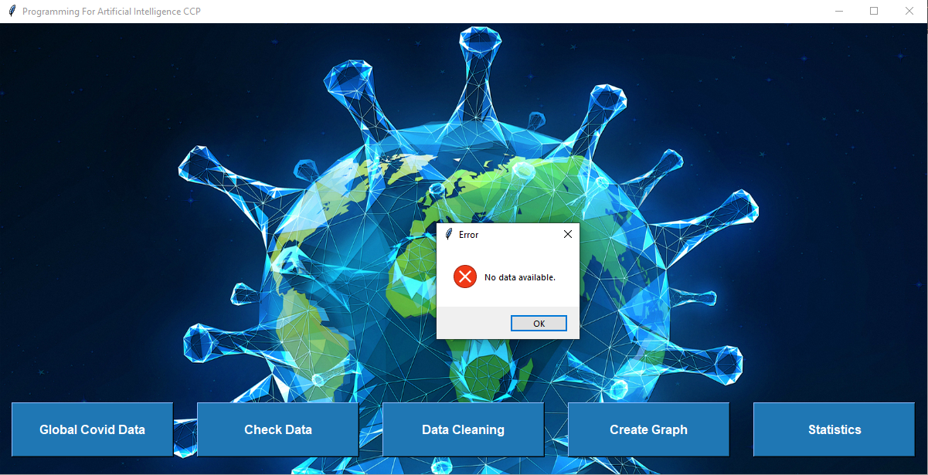
GRAPHIC USER INTERFACE (ERROR MESSAGE)

Slide 8
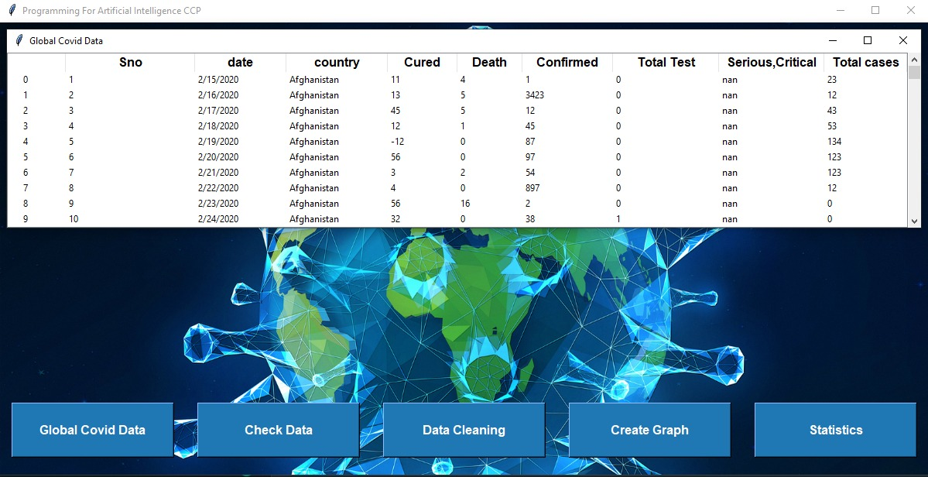
GRAPHIC USER INTERFACE (READ)

Slide 9
SOURCE CODE
for col in tree["columns"]:
tree.heading(col, text=col, anchor=tk.CENTER)
tree.column(col, width=100)
for i, row in covid_df.iterrows():
tree.insert("", "end", text=i, values=list(row))
scrollbar = ttk.Scrollbar(new_window, orient="vertical", command=tree.yview)
scrollbar.pack(side=LEFT, fill=Y)
tree.configure(yscroll=scrollbar.set)
new_window.protocol("WM_DELETE_WINDOW", new_window.destroy)
def open_file():
global covid_df
covid_df = pd.read_csv("C:/Users/MBG Traders/Desktop/worldometer_coronavirus_daily_data.csv")
new_window = Toplevel(root)
new_window.title("Global Covid Data")
style = ttk.Style(new_window)
style.configure("Custom.Treeview", background="white", foreground="black", fieldbackground="white")
style.configure("Custom.Treeview.Heading", font=("Arial", 12, "bold"))
tree = ttk.Treeview(new_window, style="Custom.Treeview")
tree.pack(fill=BOTH, expand=True, side=LEFT)
tree["columns"] = list(covid_df.columns)

Slide 10
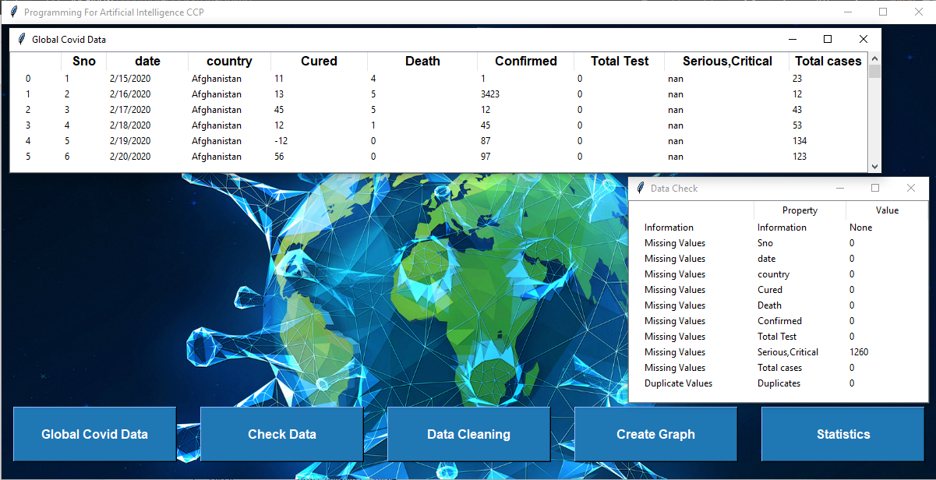
GRAPHIC USER INTERFACE (CHECK DATA)

Slide 11
SOURCE CODE
def check_data():
global covid_df
if covid_df is not None:
new_window = Toplevel(root)
new_window.title("Data Check")
tree = ttk.Treeview(new_window)
tree.pack(fill=BOTH, expand=True)
tree["columns"] = ["Property", "Value"]
tree.heading("Property", text="Property")
tree.heading("Value", text="Value")
tree.column("Property", width=150)
tree.column("Value", width=150)
info_text = covid_df.info()
tree.insert("", "end", text="Information", values=("Information", info_text))
# Display the missing values
missing_values = covid_df.isnull().sum()
for column, value in missing_values.items():
tree.insert("", "end", text=f"Missing Values", values=(column, value))
duplicates = covid_df.duplicated().sum()
tree.insert("", "end", text="Duplicate Values", values=("Duplicates", duplicates))
new_window.protocol("WM_DELETE_WINDOW", new_window.destroy)
else:
messagebox.showerror("Error", "No data available.")

Slide 12
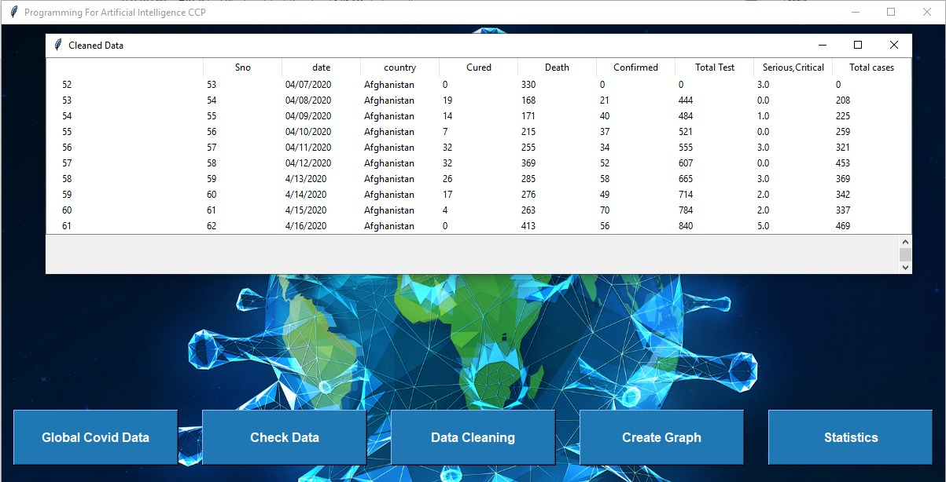
GRAPHIC USER INTERFACE (DATA CLEANING)

Slide 13
SOURCE CODE
def data_cleaning():
global covid_df
if covid_df is not None: covid_df['Serious,Critical'].fillna(value=covid_df['Serious,Critical'].mean(), inplace=True) numeric_columns = covid_df.select_dtypes(include=np.number).columns
covid_df[numeric_columns] = covid_df[numeric_columns].abs()
covid_df.loc[covid_df['Total cases'] > covid_df['Total Test'], 'Total cases'] = covid_df['Total Test']
mask = (covid_df['Confirmed'] > covid_df['Total cases'])
covid_df.loc[mask, 'Confirmed'] = covid_df.loc[mask, 'Total cases']
mask = (covid_df['Cured'] > covid_df['Confirmed'])
covid_df.loc[mask, 'Cured'] = covid_df.loc[mask, 'Confirmed'].apply(lambda x: random.randint(0, x - 1) if x > 0 else 0)
covid_df['Cured'] = covid_df['Cured'].clip(lower=0) # Set negative values to 0
sum_values = covid_df[['Cured', 'Confirmed', 'Death']].sum(axis=1)
covid_df['Total cases'] = sum_values
covid_df.loc[covid_df['Total cases'] > covid_df['Total Test'], 'Total cases'] = covid_df['Total Test']

Slide 14
SOURCE CODE
new_window = Toplevel(root)
new_window.title("Cleaned Data")
tree = ttk.Treeview(new_window)
tree.pack(fill=BOTH, expand=True)
tree["columns"] = list(covid_df.columns)
for col in tree["columns"]:
tree.heading(col, text=col, anchor=tk.CENTER)
tree.column(col, width=100)
for i, row in covid_df.iterrows():
tree.insert("", "end", text=i, values=list(row))
scrollbar = ttk.Scrollbar(new_window, orient="vertical", command=tree.yview)
scrollbar.pack(side=RIGHT, fill=Y)
tree.configure(yscroll=scrollbar.set)
new_window.protocol("WM_DELETE_WINDOW", new_window.destroy)
else:
messagebox.showerror("Error", "No data available.")

Slide 15
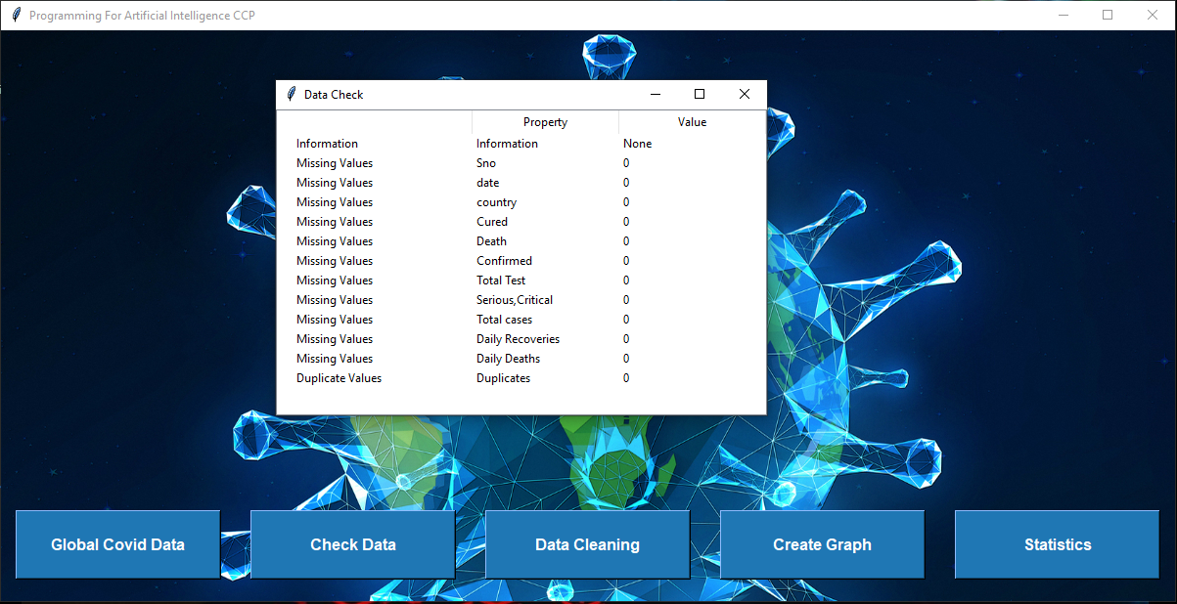
GRAPHIC USER INTERFACE (CHECK DATA AGAIN)

Slide 16
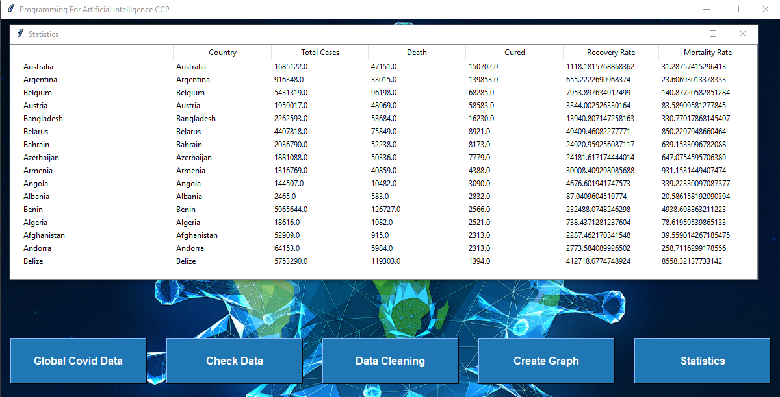
GRAPHIC USER INTERFACE (STATISTICS)

Slide 17
SOURCE CODE
def show_stats():
global covid_df, average_daily_cases
if covid_df is not None:
covid_df['Daily Recoveries'] = covid_df['Cured'].diff()
covid_df['Daily Deaths'] = covid_df['Death'].diff()
countrywise = pd.pivot_table(covid_df, values=["Total cases", "Death", "Cured"], index="country", aggfunc=max)
countrywise["Recovery Rate"] = countrywise["Cured"] * 100 / countrywise["Total cases"]
countrywise["Mortality Rate"] = countrywise["Death"] * 100 / countrywise["Total cases"]
countrywise = countrywise.sort_values(by="Total cases", ascending=False)
stats_window = Toplevel(root)
stats_window.title("Statistics")
tree = ttk.Treeview(stats_window)
tree.pack(fill=BOTH, expand=True)
columns = ["Country", "Total Cases", "Death", "Cured", "Recovery Rate", "Mortality Rate"]
tree["columns"] = columns
for col in columns:
tree.heading(col, text=col)
tree.column(col, width=100)
for i, row in countrywise.iterrows():
values = [i] + list(row)
tree.insert("", "end", text=i, values=values)
stats_window.protocol("WM_DELETE_WINDOW", stats_window.destroy)
else:
messagebox.showerror("Error", "No data available.")

Slide 18
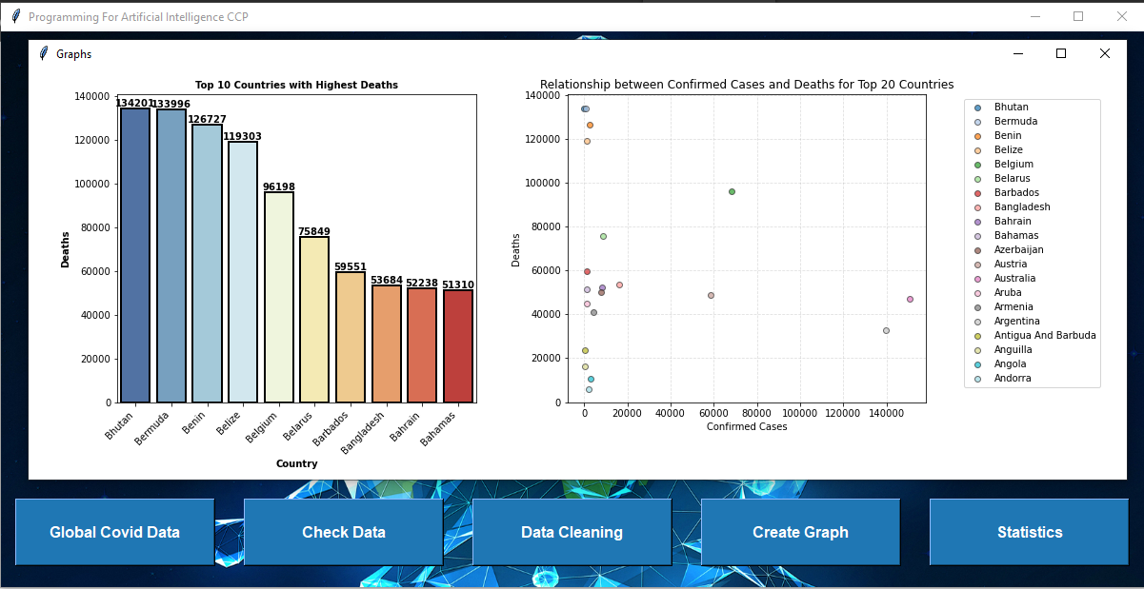
GRAPHIC USER INTERFACE (GRAPHS)

Slide 19
SOURCE CODE
def show_graphs():
global covid_df
if covid_df is not None:
graphs_window = Toplevel(root)
graphs_window.title("Graphs")
grid = plt.GridSpec(1, 2)
# Top 10 countries with the highest number of deaths
top_10_deaths = covid_df.groupby("country")["Death"].max().nlargest(10).reset_index()
ax1 = plt.subplot(grid[0, 0])
ax1.set_title("Top 10 Countries with Highest Deaths", size=10, fontweight='bold')
sns.barplot(data=top_10_deaths, x="country", y="Death", linewidth=2, edgecolor='black', palette='RdYlBu_r', ax=ax1)
for i, bar in enumerate(ax1.patches):
ax1.text(bar.get_x() + bar.get_width() / 2, bar.get_height(), top_10_deaths.iloc[i]["Death"],
ha='center', va='bottom', color='black', fontweight='bold')
ax1.set_xlabel("Country", size=10, fontweight='bold')
ax1.set_ylabel("Deaths", size=10, fontweight='bold')
ax1.set_xticklabels(ax1.get_xticklabels(), rotation=45, ha="right")

Slide 20
SOURCE CODE
# Scatter plot for confirmed cases and deaths of top 20 countries
ax2 = plt.subplot(grid[0, 1])
top_20_countries = covid_df.groupby("country").max().nlargest(20, "Death")
confirmed_cases = top_20_countries["Total cases"]
deaths = top_20_countries["Death"]
countries = top_20_countries.index
colors = plt.cm.tab20(np.linspace(0, 1, len(countries)))
for i, country in enumerate(countries):
country_cases = confirmed_cases[countries == country]
country_deaths = deaths[countries == country]
highest_rate_index = (country_cases / country_cases.sum()).idxmax()
ax2.scatter(country_cases, country_deaths, color=colors[i], alpha=0.7, edgecolors="#333333", label=country)
ax2.set_xlabel("Confirmed Cases")
ax2.set_ylabel("Deaths")
ax2.set_title("Relationship between Confirmed Cases and Deaths for Top 20 Countries")
ax2.grid(True, linestyle="--", alpha=0.4)
ax2.legend(loc='upper right', bbox_to_anchor=(1.5, 1))
canvas = FigureCanvasTkAgg(plt.gcf(), master=graphs_window)
canvas.draw()
canvas.get_tk_widget().pack(side=tkinter.TOP, fill=tkinter.BOTH, expand=True)
graphs_window.protocol("WM_DELETE_WINDOW", graphs_window.destroy)
else:
messagebox.showerror("Error", "No data available.")/

Slide 21
SOURCE CODE
jpeg_image = Image.open("C:/Users/MBG Traders/Desktop/earth.jpg")
png_image = jpeg_image.convert("RGBA")
image = ImageTk.PhotoImage(png_image)
root.geometry(f"{image.width()}x{image.height()}")
img = Label(root, image=image)
img.place(x=0, y=0, relwidth=1, relheight=1)

Slide 22

SOURCE CODE OF BUTTONS
# Create Open File button
open_button = Button(
root,
text="Global Covid Data",
relief=RAISED,
bg=button_bg_color,
fg="white",
font=("Arial", 12, "bold"),
width=20,
height=3,
activebackground=button_bg_color,
activeforeground="white",
command=open_file
)
# Check Data button
button_check_data = Button(
root,
text="Check Data",
relief=RAISED,
bg=button_bg_color,
fg="white",
font=("Arial", 12, "bold"),
width=20,
height=3,
activebackground=button_bg_color,
activeforeground="white",
command=check_data
)
button_check_data.place(relx=0.3, rely=0.9, anchor="center")

Slide 23
SOURCE CODE OF BUTTONS
# Create Graph button
button_create_graph = Button(
root,
text="Create Graph",
relief=RAISED,
bg=button_bg_color,
fg="white",
font=("Arial", 12, "bold"),
width=20,
height=3,
activebackground=button_bg_color,
activeforeground="white",
command=show_graphs
)
button_create_graph.place(relx=0.7, rely=0.9, anchor="center")
# Stats button
button_Stats = Button(
root,
text="Statistics",
relief=RAISED,
bg=button_bg_color,
fg="white",
font=("Arial", 12, "bold"),
width=20,
height=3,
activebackground=button_bg_color,
activeforeground="white",
command=show_stats
)
button_Stats.place(relx=0.9, rely=0.9, anchor="center")
root.mainloop()

Slide 24
02
INDIA COVID DATA

Slide 25
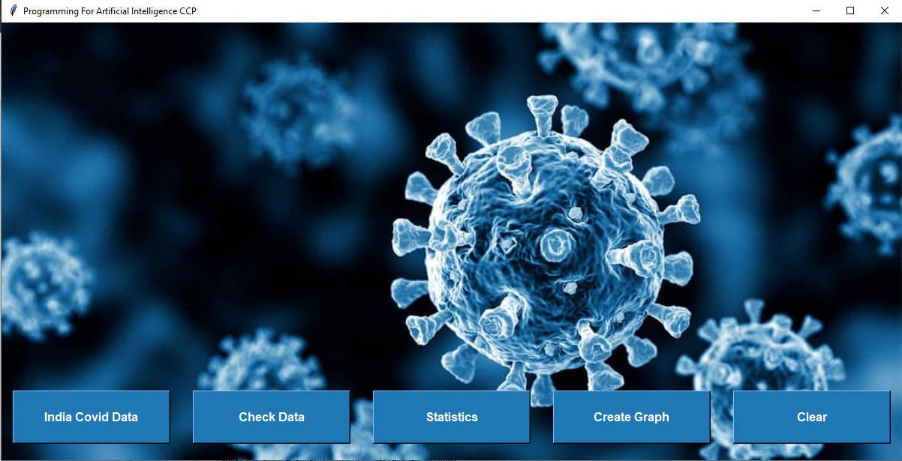
GUI

Slide 26
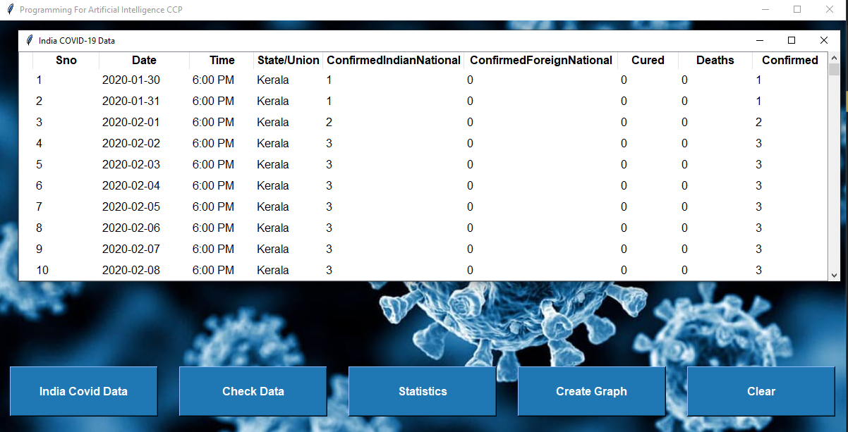
INDIA COVID DATA

Slide 27
INDIA COVID DATA
def open_file():
global covid_
path = 'C:/Users/MBG Traders/Downloads/dataset_without_outliers.csv
covid_df = pd.read_csv(path)
new_window = Toplevel(root) # Create a new top-level window
new_window.title("India COVID-19 Data")
tree = ttk.Treeview(new_window)
tree["columns"] = tuple(covid_df.columns)
style = ttk.Style(new_window)
style.configure("Treeview", font=("Arial", 12), rowheight=30)
style.configure("Treeview.Heading", font=("Arial", 12, "bold"))
for column in covid_df.columns:
tree.heading(column, text=column)
tree.column(column, width=100)
for index, row in covid_df.iterrows():
tree.insert("", "end", text=index, values=tuple(row))
scrollbar = ttk.Scrollbar(new_window, orient="vertical", command=tree.yview)
tree.configure(yscroll=scrollbar.set)
tree.pack(side="left", fill="both", expand=True)
scrollbar.pack(side="right", fill="y")

Slide 28
01
DATA CLEANING

Slide 29
Z-score Range: Outliers
Load the dataset from a CSV file using pandas read_csv.
Iterate over selected columns, convert them to numeric type, and calculate z-scores for outlier detection.
Set a threshold value and identify outliers based on the absolute z-scores exceeding the threshold.
Remove the outliers from the dataset and save the modified dataset to a new CSV file.
CODE
# Load the dataset (assuming it's stored in a CSV file)
data = pd.read_csv("C:\\Users\Lenovo\Downloads\\covid_19_india.csv")
# Select the column(s) to check for outliers
columns_to_check = ['ConfirmedIndianNational', 'ConfirmedForeignNational', 'Cured', 'Deaths', 'Confirmed']
# Iterate over the selected columns
for column in columns_to_check:
# Convert the column to numeric data type
data[column] = pd.to_numeric(data[column], errors='coerce')
# Calculate z-scores for the column
z_scores = zscore(data[column].dropna())
# Set threshold for outlier detection
threshold = 3
# Identify outliers
outliers = np.where(np.abs(z_scores) > threshold)[0]
# Remove outliers from the dataset
data = data.drop(data.index[outliers])
# Save the modified dataset to a new file
data.to_csv("C:\\Users\Lenovo\Downloads\\your_dataset_without_outliers.csv", index=False)
print("saved")

Slide 30
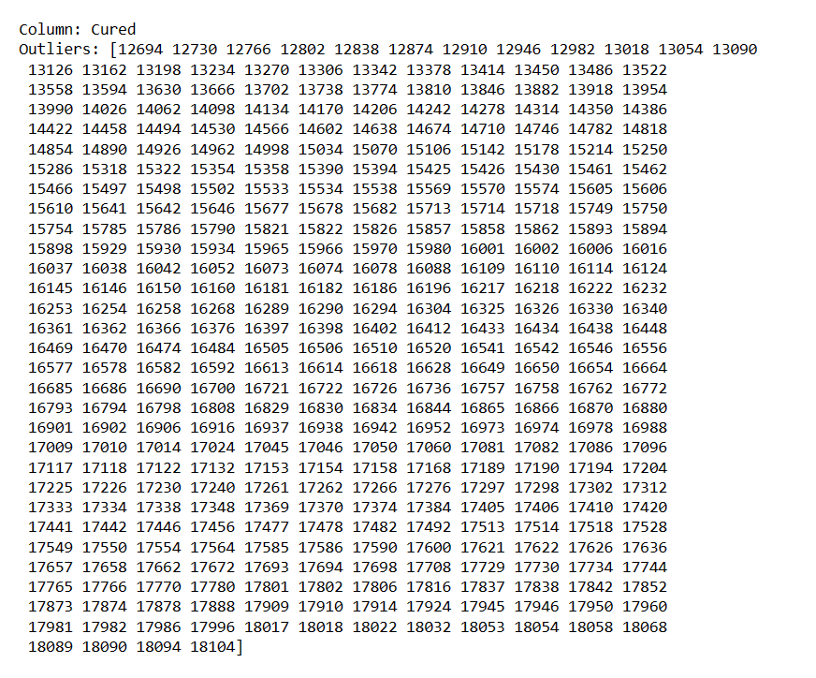
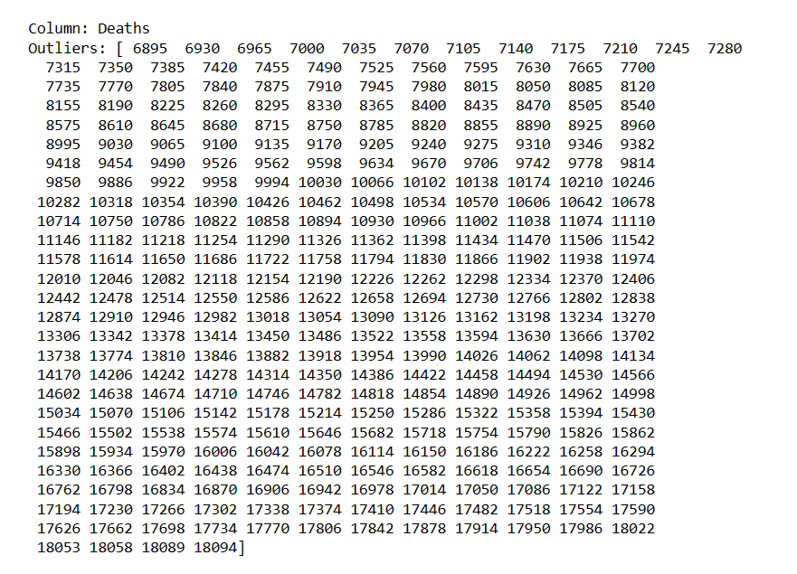
RESULTS
CURED COLUMN OUTLIERS:
DEATHS COLUMN OUTLIERS:

Slide 31
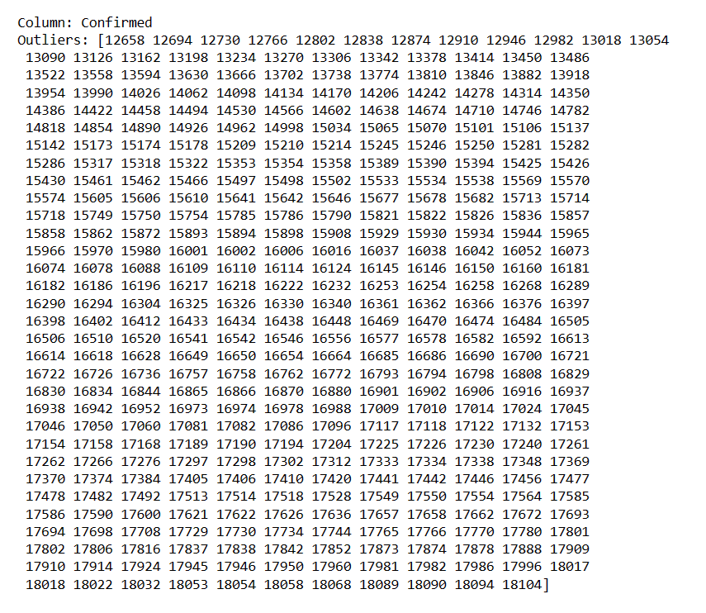
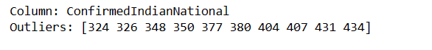
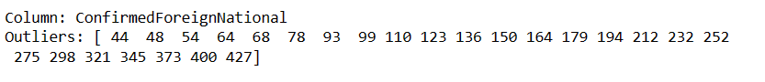
RESULTS
Confirmed COLUMN OUTLIERS:
ConfrmedIndianNational COLUMN OUTLIERS:
ConfrmedForeignNational COLUMN OUTLIERS:

Slide 32
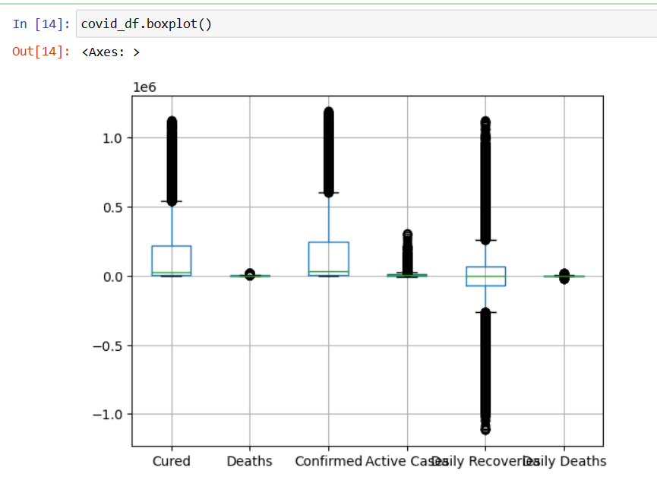
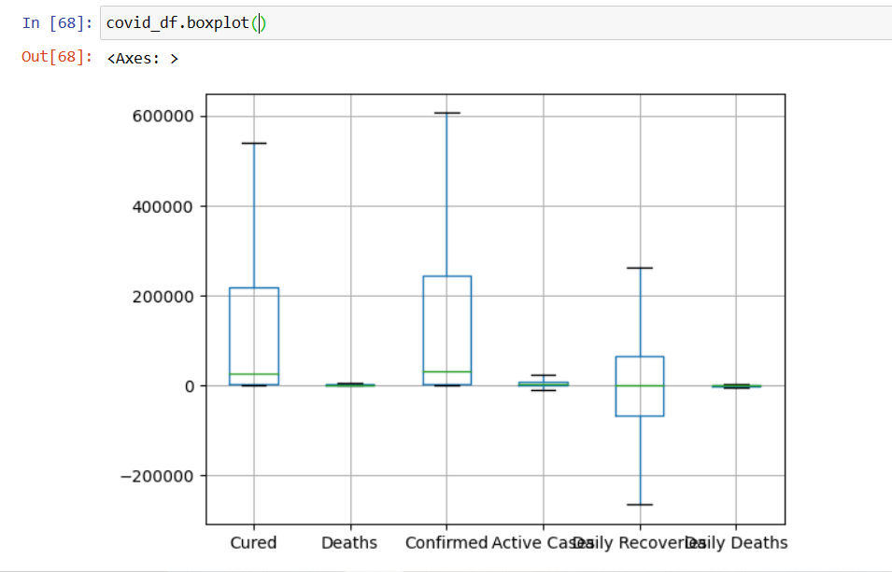
BEFORE REMOVING OUTLIERS
AFTER REMOVING OUTLIERS

Slide 33
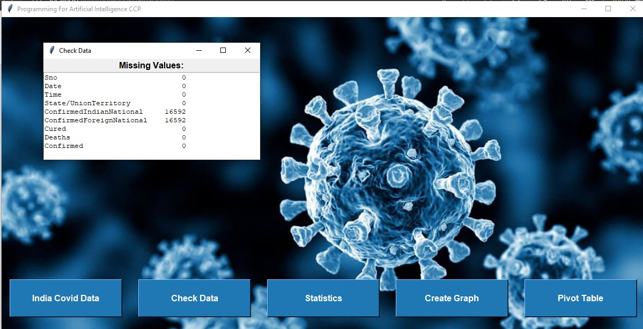
Missing Values
def check_data():
new_window = Toplevel(root) # Create a new top-level window
new_window.title("Check Data")
# Display missing values
missing_values_label = Label(new_window, text="Missing Values:", font=("Arial", 12, "bold"))
missing_values_label.pack()
missing_values_text = Text(new_window, height=10, width=50)
missing_values_text.insert(END, covid_df.isnull().sum().to_string()) # Convert covid_df.isnull().sum() to string
missing_values_text.pack()

Slide 34
02
STATISTICS

Slide 35
def show_statistics():
global average_daily_cases # Access the global average_daily_cases variable
new_window = Toplevel(root) # Create a new top-level window
new_window.title("Statistics")
# Calculate active cases
covid_df["Active Cases"] = covid_df["Confirmed"] - (covid_df["Cured"] + covid_df["Deaths"])
# Sort the data by date in ascending order
covid_df['Date'] = pd.to_datetime(covid_df['Date'])
covid_df.sort_values('Date', inplace=True)
# Calculate daily recoveries and deaths
covid_df['Daily Recoveries'] = covid_df['Cured'].diff()
covid_df['Daily Deaths'] = covid_df['Deaths'].diff()
# Calculate average daily cases
average_daily_cases = covid_df['Confirmed'].sum() / len(covid_df)
# Add average daily cases to the dataset
covid_df['Average Daily Cases'] = average_daily_cases
# Drop unnecessary columns
covid_df_dropped = covid_df.drop(["Sno", "Time", "ConfirmedIndianNational", "ConfirmedForeignNational"], axis=1)
# Create a Treeview widget to display the data
tree = ttk.Treeview(new_window)
tree["columns"] = tuple(covid_df_dropped.columns)
# Configure style for Treeview widget
style = ttk.Style(new_window)
style.configure("Treeview", font=("Arial", 12), rowheight=30)
# Configure style for heading
style.configure("Treeview.Heading", font=("Arial", 12, "bold"))
# Add columns to the Treeview
for column in covid_df_dropped.columns:
tree.heading(column, text=column)
tree.column(column, width=100)
# Insert data into the Treeview
for index, row in covid_df_dropped.iterrows():
tree.insert("", "end", text=index, values=tuple(row))
# Create scrollbar
scrollbar = ttk.Scrollbar(new_window, orient="vertical",
command=tree.yview)
tree.configure(yscroll=scrollbar.set)
# Pack the Treeview and scrollbar
tree.pack(side="left", fill="both", expand=True)
scrollbar.pack(side="right", fill="y")

Slide 36
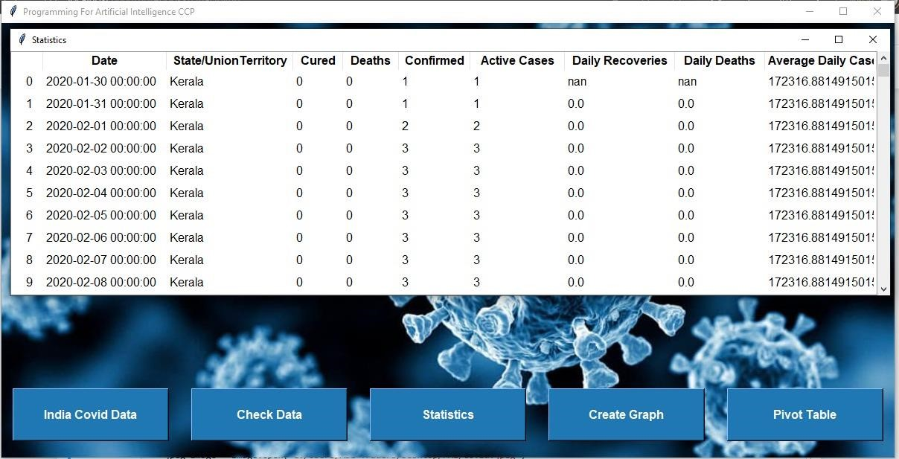
The show_statistics function displays COVID-19 statistics in a new window.
It calculates active cases, daily recoveries, daily deaths, and average daily cases.
The data is presented in a Treeview widget with columns for different statistics.
A scrollbar is included to facilitate vertical scrolling through the data if needed.

Slide 37
SHOWING RECOVERY AND MORTALITY
RATE USING PIVOT TABLE

Slide 38
# Define columns
tree["columns"] = statewise.columns.tolist()
# Format column headers
for column in tree["columns"]:
tree.heading(column, text=column, anchor=tk.CENTER)
# Insert data rows and assign tags
for i, (_, row) in enumerate(statewise.iterrows()):
values = row.tolist()
tree.insert("", tk.END, values=values, tags=(f"even_row_{i}",))
# Apply color gradient to the Treeview rows
for i in range(len(statewise)):
if i % 2 == 0:
tree.tag_configure(f"even_row_{i}", background="#FFFFFF")
else:
tree.tag_configure(f"even_row_{i}", background="#F0F0F0")
# Display the Treeview widget
tree.pack(fill=tk.BOTH, expand=True)
new_window.mainloop()
def show_pivot_table():
new_window = tk.Toplevel(root)
new_window.title("Pivot Table")
# Create a pivot table for statewise data
statewise = pd.pivot_table(covid_df, values=["Confirmed", "Deaths", "Cured"], index="State/UnionTerritory", aggfunc=max)
# Add recovery rate and mortality rate columns
statewise["Recovery Rate"] = statewise["Cured"] * 100 / statewise["Confirmed"]
statewise["Mortality Rate"] = statewise["Deaths"] * 100 / statewise["Confirmed"]
# Sort the statewise data by confirmed cases
statewise = statewise.sort_values(by="Confirmed", ascending=False)
# Create a Treeview widget
tree = ttk.Treeview(new_window)

Slide 39
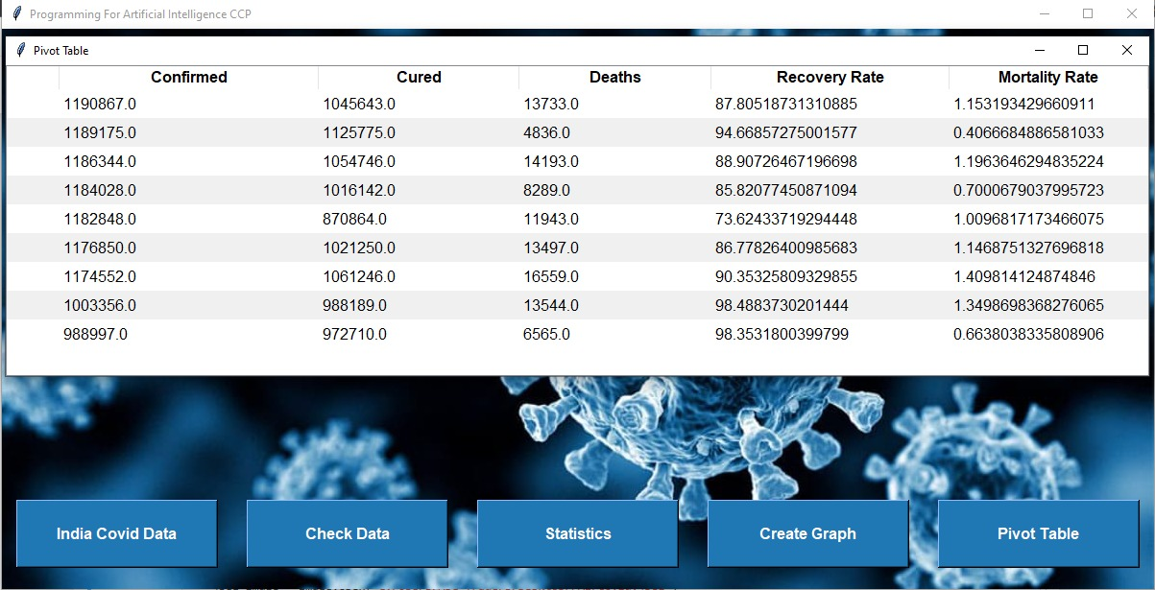
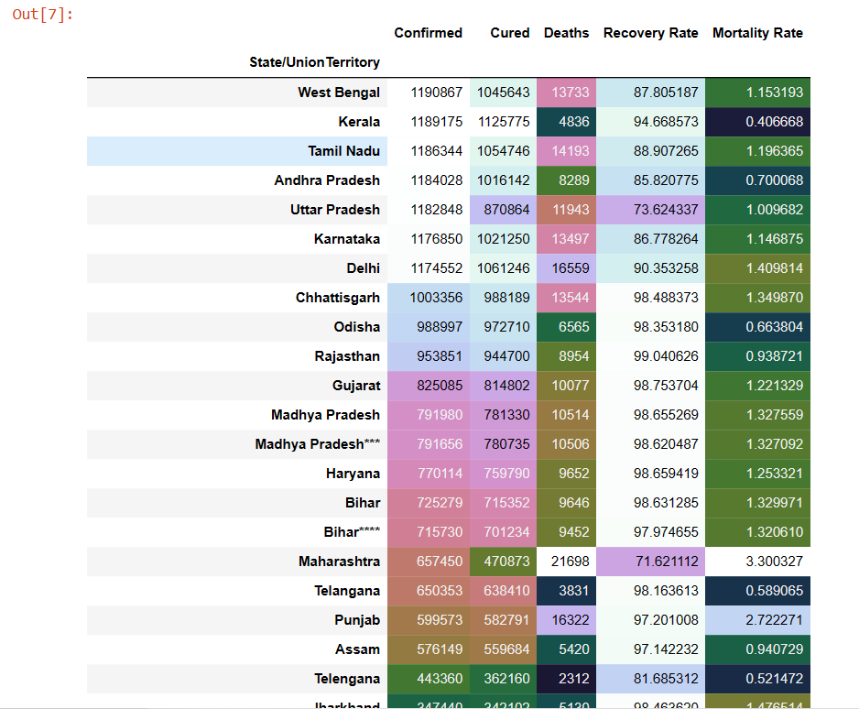

Slide 40
03
GRAPHS

Slide 41
TOP 10 STATES WITH HIGHEST ACTIVE CASES:

Slide 42
ax.set_xlabel("State/Union Territory", size=14, fontweight='bold')
ax.set_ylabel("Active Cases", size=14, fontweight='bold')
ax.set_xticklabels(ax.get_xticklabels(), rotation=45, ha="right")
# Set the background color
plt.gca().set_facecolor('#333333')
# Remove the spines
plt.gca().spines['top'].set_visible(False)
plt.gca().spines['right'].set_visible(False)
# Add a grid for better readability
plt.grid(True, linestyle='--', alpha=0.4)
plt.tight_layout()
# Embed the plot into the GUI
canvas = FigureCanvasTkAgg(fig, master=new_window)
canvas.draw()
canvas.get_tk_widget().pack()
# Run the GUI event loop
new_window.mainloop()
def Active_Cases():
from matplotlib.backends.backend_tkagg import FigureCanvasTkAgg
from matplotlib.figure import Figure
# Create the GUI window
new_window = Toplevel(root)
new_window.title(“Graph")
# Get the top 10 states with the highest number of active cases
top_10_active_cases = covid_df.groupby("State/UnionTerritory")[“Active Casses"].max()
.nlargest(10).reset_index()
# Create the bar plot
fig = plt.figure(figsize=(12, 8))
plt.title("Top 10 States with Highest Active Cases", size=20, fontweight='bold')
ax = sns.barplot(data=top_10_active_cases, x="State/UnionTerritory",
y=" Active Casses ",linewidth=2, edgecolor='black', palette='coolwarm’)
# Add labels to each bar
for i, bar in enumerate(ax.patches):
ax.text(bar.get_x() + bar.get_width() / 2, bar.get_height(), top_10_active_cases.iloc[i][" Active Casses "],
ha='center', va='bottom', color='white', fontweight='bold')

Slide 43
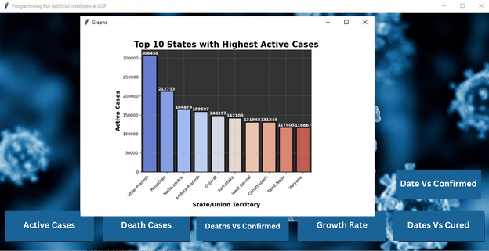
Insights and Takeaways
The visualization helps identify the states/union territories currently experiencing the highest active COVID-19 cases.
It provides a quick and effective way to compare the severity of the pandemic across different regions.

Slide 44
TOP 10 STATES WITH HIGHEST DEATH CASES:

Slide 45
def Deaths():
# Create the GUI window
new_window = Toplevel(root)
new_window.title(“Graph")
# Get the top 10 cities with the highest number of deaths
top_10_deaths = covid_df.groupby("State/UnionTerritory")["Deaths"].max().nlargest(10).reset_index()
# Create the bar plot
fig = plt.figure(figsize=(7, 6))
plt.title("Top 10 States with Highest Deaths", size=20, fontweight='bold')
ax = sns.barplot(data=top_10_deaths, x="State/UnionTerritory", y="Deaths", linewidth=2, edgecolor='black', palette='RdYlBu_r')
# Add labels to each bar
for i, bar in enumerate(ax.patches):
ax.text(bar.get_x() + bar.get_width() / 2, bar.get_height(), top_10_deaths.iloc[i]["Deaths"],
ha='center', va='bottom', color='white', fontweight='bold')
ax.set_xlabel("State/UnionTerritory", size=14, fontweight='bold')
ax.set_ylabel("Deaths", size=14, fontweight='bold')
ax.set_xticklabels(ax.get_xticklabels(), rotation=45, ha="right")
# Set the background color
plt.gca().set_facecolor('#008080')
# Remove the spines
plt.gca().spines['top'].set_visible(False)
plt.gca().spines['right'].set_visible(False)
# Add a grid for better readability
plt.grid(True, linestyle='--', alpha=0.4)
plt.tight_layout()
# Create the FigureCanvasTkAgg widget
canvas = FigureCanvasTkAgg(fig, master=window)
canvas.draw()
canvas.get_tk_widget().pack()
# Start the GUI event loop
window.mainloop()

Slide 46
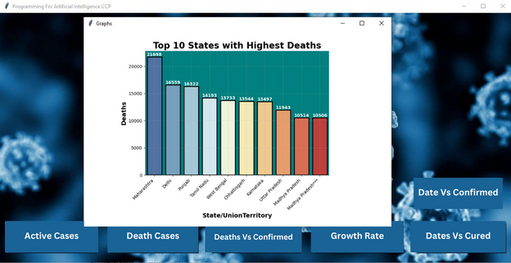
The bar plot highlights the top 10 states/union territories with the highest COVID-19 death rates, providing insights for targeted interventions and resource allocation.

Slide 47
GROWTH RATE OF ACTIVE CASES
FOR TOP 10 STATES

Slide 48
def Growth_Rate():
fig = plt.figure(figsize=(7, 6))
# Filter the data for top 10 states with highest active cases
top_10_states = covid_df.groupby("State/UnionTerritory")[Active Cases"].max().nlargest(10)
filtered_df = covid_df[covid_df["State/UnionTerritory"].isin(top_10_states.index)]
# Create the line plot with seaborn
ax = sns.lineplot(data=filtered_df, x="Date", y=“Active Cases", hue="State/UnionTerritory")
# Set the title
plt.title("Growth Rate of Active Cases for Top 10 States", size=20, fontweight='bold')
ax.set_xlabel("Dates", size=14, fontweight='bold')
ax.set_ylabel("Active Cases", size=14, fontweight='bold')
# Rotate the x-axis labels
plt.xticks(rotation=45)
# Adjust the legend to be outside the plot
ax.legend(bbox_to_anchor=(1.05, 1), loc='upper left')
# Set the background color
plt.gca().set_facecolor('#F5FFFA')
# Remove the spines
plt.gca().spines['top'].set_visible(False)
plt.gca().spines['right'].set_visible(False)
# Create the FigureCanvasTkAgg widget
canvas = FigureCanvasTkAgg(fig, master=window)
canvas.draw()
canvas.get_tk_widget().pack()
# Start the GUI event loop
window.mainloop()

Slide 49
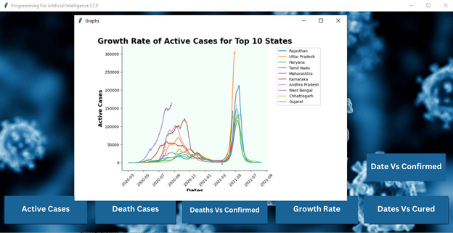

Slide 50
Confirmed Vs Deaths

Slide 51
# Set the figure size
fig = plt.figure(figsize=(7, 6))
# Define the data
top_20_cities = covid_df.groupby("State/UnionTerritory").max().nlargest(20, "Deaths")
confirmed_cases = top_20_cities["Confirmed"]
deaths = top_20_cities["Deaths"]
cities = top_20_cities.index
# Generate a color palette
colors = plt.cm.tab20(np.linspace(0, 1, len(cities)))
# Create the scatter plot with customized style
for i, city in enumerate(cities):
city_cases = confirmed_cases[cities == city]
city_deaths = deaths[cities == city]
highest_rate_index = (city_cases / city_cases.sum()).idxmax()
plt.scatter(city_cases, city_deaths, color=colors[i], alpha=0.7, edgecolors="#333333", label=city)
# Set the axis labels and title
plt.xlabel("Confirmed Cases", size=14, fontweight='bold')
plt.ylabel("Deaths", size=14, fontweight='bold')
plt.title(" Confirmed Cases and Deaths for Top 20 Cities", size=20, fontweight='bold')
# Add a grid for better readability
plt.grid(True, linestyle="--", alpha=0.4)
# Move the legend to the desired location
plt.legend(loc='upper right', bbox_to_anchor=(1.5, 1))
# Set the background color
plt.gca().set_facecolor('#E6E6FA')
# Remove the spines
plt.gca().spines['top'].set_visible(False)
plt.gca().spines['right'].set_visible(False)
# Create the FigureCanvasTkAgg widget
canvas = FigureCanvasTkAgg(fig, master=window)
canvas.draw()
canvas.get_tk_widget().pack()
# Start the GUI event loop
window.mainloop()

Slide 52
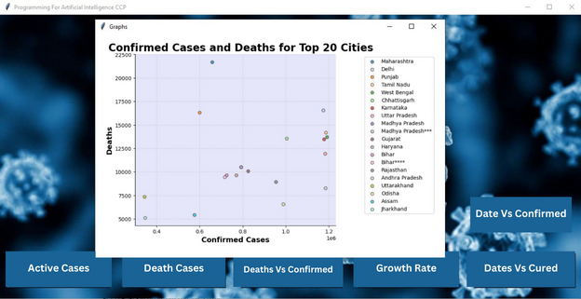

Slide 53
CONFIRMED CASES AND
CURED CASES FOR TOP 10 DATES

Slide 54
# TOP 10 DATES FOR CURED
date_confirmed = covid_df.groupby("Date")["Cured"].sum()
# Sort the dates in descending order and select the top 10 dates
top_10_dates = date_confirmed.sort_values(ascending=False).head(10).index
# Filter the data for the top 10 dates
top_10_data = covid_df[covid_df["Date"].isin(top_10_dates)]
# Group the filtered data by date and calculate the total confirmed cases for each date
top_10_date_confirmed = top_10_data.groupby("Date")["Cured"].sum()
# Get the city names for each date
city_names = top_10_data.groupby("Date")["State/UnionTerritory"].first()
# Plot the top 10 dates against the number of confirmed cases
plt.figure(figsize=(7, 6))
plt.plot(top_10_date_confirmed.index, top_10_date_confirmed.values, marker='o', linestyle='-', color='red')
# Add city names for each dot
for date, cured, city_name in zip(top_10_date_confirmed.index, top_10_date_confirmed.values, city_names):
plt.text(date, cured, city_name, ha='center', va='bottom')
plt.xlabel("Date")
plt.ylabel("Cured Cases")
plt.title("Cured Cases for Top 10 Dates", size=20, fontweight='bold')
# Set the background color
plt.gca().set_facecolor('gray')
# Add a grid for better readability
plt.grid(True, linestyle="--", alpha=0.4)
# Remove the spines
plt.gca().spines['top'].set_visible(False)
plt.gca().spines['right'].set_visible(False)
plt.xticks(rotation=45)
plt.tight_layout()
# Create the FigureCanvasTkAgg widget
canvas = FigureCanvasTkAgg(fig, master=window)
canvas.draw()
canvas.get_tk_widget().pack()
# Start the GUI event loop
window.mainloop()

Slide 55
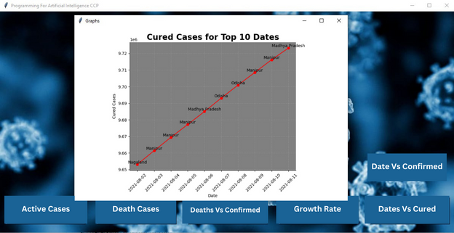

Slide 56
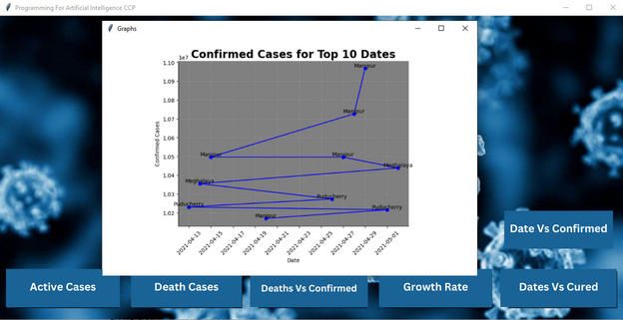
# Group the data by date and calculate the total confirmed cases for each date
date_confirmed = covid_df.groupby("Date")["Confirmed"].sum()

Slide 57
03
COVID VACCINATION DATA
Analyzing Vaccination Progress and Coverage in India

Slide 58
Insights and Trends
1. Dataset Description
2. Data Coverage
3. Analysis and Insights
Source: Kaggle
Dataset Title: COVID-19 Vaccination Data - Statewise
Time period covered: 2021
States included: Delhi, India, Other (7420)
Vaccination Progress: Analyzing the overall progress of COVID-19 vaccination across states.
State Comparison: Investigating variations in vaccination coverage and rates among different states.

Slide 59
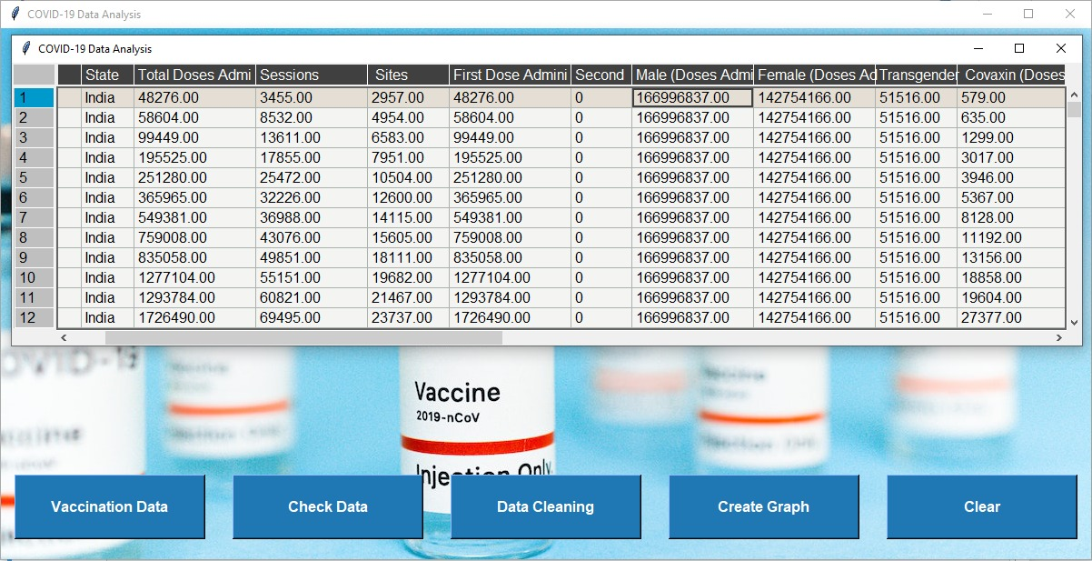
VACCINATION DATA

Slide 60
VACCINATION DATA

Slide 61
DATA CLEANING
Data cleaning is an essential step in the analysis process as it ensures the accuracy and reliability of the dataset, leading to more meaningful insights.
The data cleaning process involves identifying and handling missing values, outliers, inconsistent formatting, and other data quality issues.
By performing thorough data cleaning, analysts can improve the quality and reliability of the dataset, enabling more accurate analysis and insights.

Slide 62
DATA CLEANING PROCESS
def check_data():
new_window = Toplevel(root) # Create a new top-level window
new_window.title("Check Data")
# Display missing values
missing_values_label = Label(new_window, text="Missing Values:", font=("Arial", 12, "bold"))
missing_values_label.pack()
missing_values_text = Text(new_window, height=10, width=50)
missing_values_text.insert(END, covid_df.isnull().sum().to_string()) # Convert covid_df.isnull().sum() to string
missing_values_text.pack()
AFTER CHECKING DATA
def perform_data_cleaning():
global df # Access the global df variable
columns_to_fill = df.columns[df.columns != 'Second Dose Administered']
for column in columns_to_fill:
df[column].fillna(method='bfill', inplace=True)
df[column].fillna(method='ffill', inplace=True)
show_data()

Slide 63
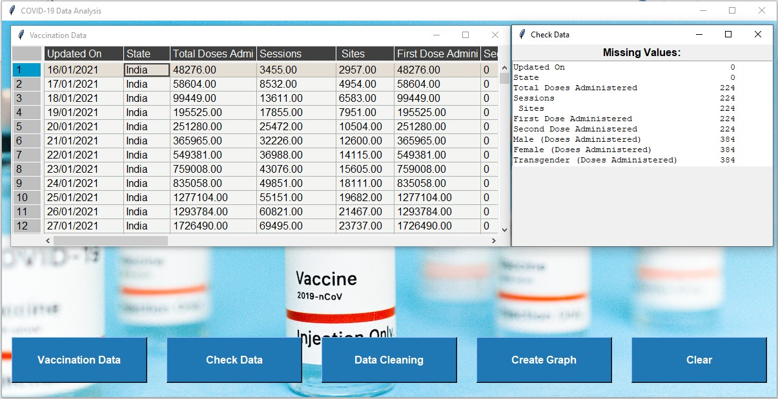
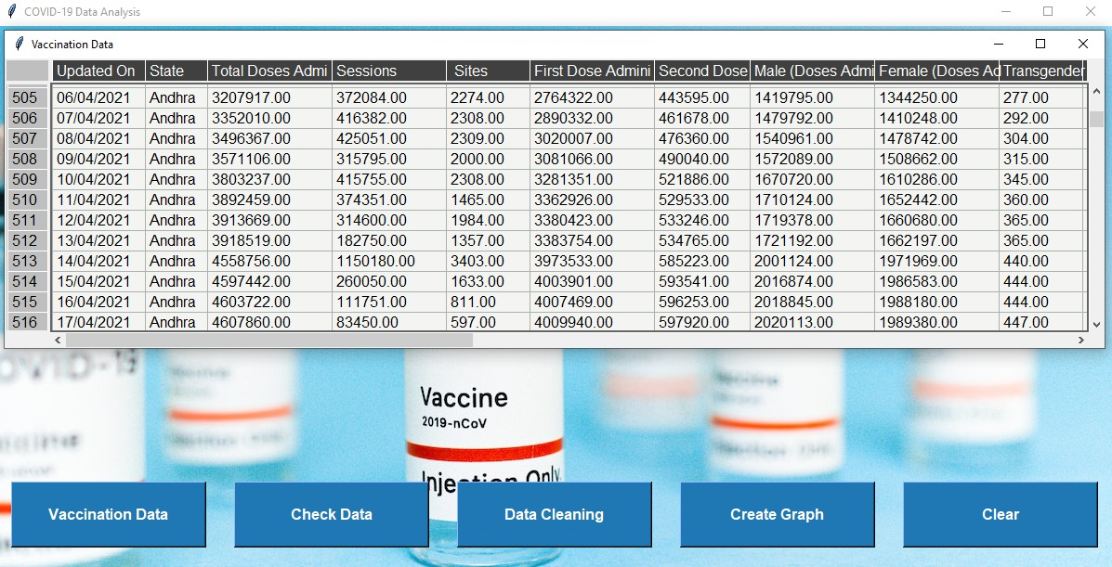
DATA CLEANING PROCESS VISUALIZATION
BEFORE DATA CLEANING
AFTER DATA CLEANING

Slide 64
VISUALIZING INSIGHTS: THE POWER OF GRAPHS
Importance of Graphs:
Graphs simplify complex information, making it easier to understand patterns and trends in the data.
Graphs enhance communication by presenting data in a visually appealing and engaging manner.
Graphs summarize large datasets and highlight key findings for efficient comprehension.
Benefits of Using Graphs:
Enhanced comprehension: Graphs simplify complex data, aiding in understanding and drawing conclusions.
Revealing patterns and trends: Graphical representations highlight relationships and trends in the data.
Supporting data-driven decisions: Graphs provide a visual basis for informed decision making.

Slide 65
GRAPHICAL VISUALIZATION OF COVID-19 VACCINATION DATA
Bar Chart of Least 5 Vaccinated States in India
def create_graph():
global df # Access the global df variable
if df is not None:
# Create bar chart
min_vac = df.groupby('State')['Total Doses Administered'].sum().to_frame('Total')
min_vac = min_vac.sort_values('Total').head(5)
figure1 = Figure(figsize=(5, 5))
subplot1 = figure1.add_subplot(111)
subplot1.bar(min_vac.index, min_vac['Total'], color='lightsteelblue')
subplot1.set_title("Least 5 Vaccinated States in India", size=10)
subplot1.set_xlabel("States")
subplot1.set_ylabel("Vaccination")
subplot1.tick_params(axis='x', labelrotation=45) # Rotate x-axis labels
bar1 = FigureCanvasTkAgg(figure1, root)
bar1.get_tk_widget().place(relx=0.4999, rely=0.4, anchor="center") # Place the bar chart in the center

Slide 66
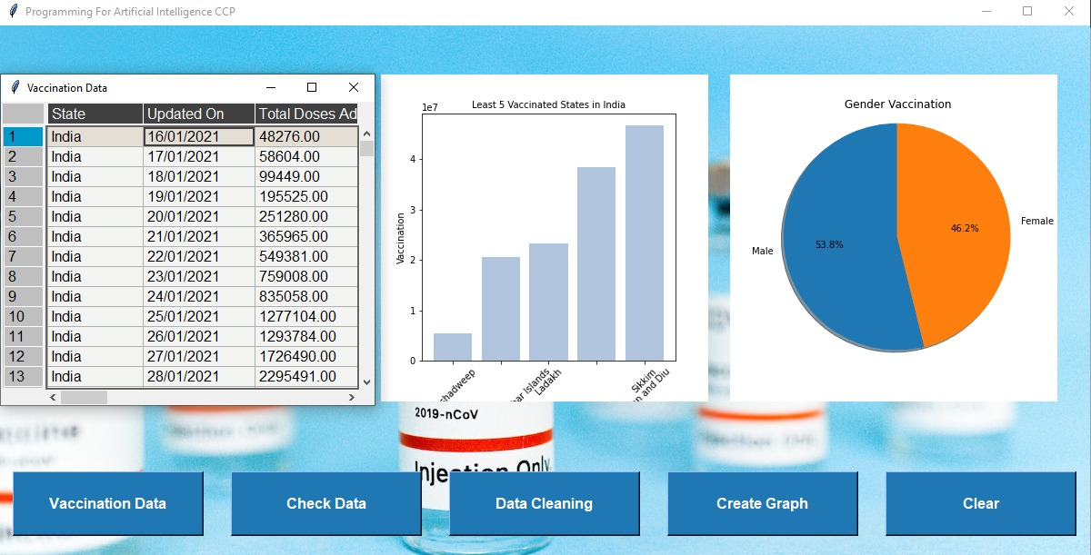
Bar Chart of Least 5 Vaccinated States in India

Slide 67
Gender-wise Distribution of COVID-19 Vaccination
# Create pie chart
male = df["Male(Individuals Vaccinated)"].sum()
female = df["Female(Individuals Vaccinated)"].sum()
labels = ["Male", "Female"]
values = [male, female]
figure2 = Figure(figsize=(5, 5))
subplot2 = figure2.add_subplot(111)
subplot2.pie(values, labels=labels, autopct='%1.1f%%', shadow=True, startangle=90)
subplot2.set_title("Gender Vaccination")
subplot2.axis('equal')
fig_pie = FigureCanvasTkAgg(figure2, root)
fig_pie.get_tk_widget().place(relx=0.82, rely=0.4, anchor="center") # Place the pie chart on the right

Slide 68
Gender-wise Distribution of COVID-19 Vaccination

Slide 69
GUI VISUALIZATION

Slide 70
KEY INSIGHTS
Least 5 Vaccinated States in India
Gender Vaccination
The pie chart shows the distribution of COVID-19 vaccinations among genders.
Females account for a higher percentage of vaccinations (46.2%), while males make up the remaining percentage (53.8%).
This indicates that efforts should be made to encourage more males to get vaccinated.
The bar chart displays the total number of vaccine doses administered in the five states with the lowest vaccination rates.
Lakshadweep has the lowest vaccination rate, followed by Andaman and Nicobar Islands, Ladakh, Dadra and Nagar Haveli and Daman and Diu, and Sikkim
These states require focused attention and additional resources to improve vaccination coverage.

Slide 71
KEY FINDING AND INSIGHTS
The analysis of COVID-19 vaccination data, along with data cleaning, provided valuable insights into vaccination rates, gender distribution, and data quality. The graphs highlighted the least vaccinated states and the gender disparity in vaccination.
Data cleaning was performed to ensure the accuracy and reliability of the analysis. By addressing missing values and inconsistencies, the integrity of the data was enhanced, improving the quality of the findings.
The findings underscored the importance of targeted efforts and additional resources to improve vaccination coverage in the least vaccinated states. The gender disparity in vaccination also requires focused attention to ensure equitable access to vaccination for all genders.

Slide 72
04
COMPARISION

Slide 73

GUI VISUALIZATION

Slide 74
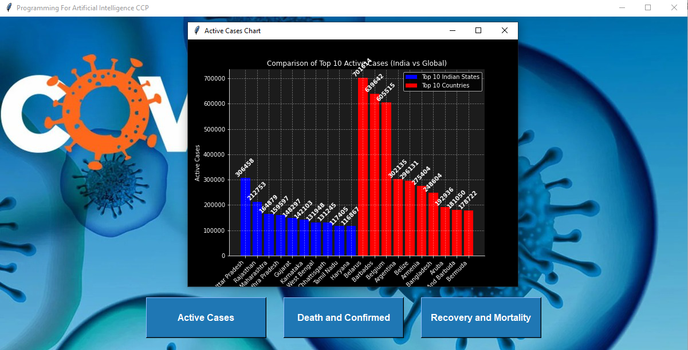
GUI VISUALIZATION (ACTIVE CASES)

Slide 75
GUI VISUALIZATION (ACTIVE CASES)
for bar in india_bars:
height = bar.get_height()
ax.text(bar.get_x() + bar.get_width() / 2, height, height, ha='center', va='bottom', color='white', fontweight='bold', fontsize=10, rotation=45)
for bar in global_bars:
height = bar.get_height()
ax.text(bar.get_x() + bar.get_width() / 2, height, height, ha='center', va='bottom', color='white', fontweight='bold', fontsize=10, rotation=45)
ax.grid(True, linestyle="--", alpha=0.4)
ax.legend(loc="upper right", bbox_to_anchor=(1, 1))
ax.set_facecolor('#1c1c1c')
ax.spines['top'].set_visible(False)
ax.spines['right'].set_visible(False)
canvas = FigureCanvasTkAgg(fig, master=active_cases_window)
canvas.draw()
canvas.get_tk_widget().pack()
def show_active_cases():
active_cases_window = Toplevel(root)
active_cases_window.title("Active Cases Chart")
india_data = pd.read_csv(r"C:\Users\MBG Traders\Downloads\your_dataset_without_outliers.csv")
india_data['Active'] = india_data['Confirmed'] - (india_data['Deaths'] + india_data['Cured'])
india_state_data = india_data.groupby("State/UnionTerritory", as_index=False)["Active"].max().nlargest(10, "Active")
global_data = pd.read_csv(r"C:\Users\MBG Traders\Desktop\worldometer_coronavirus_daily_data.csv")
global_data['Active'] = global_data['Confirmed'] - (global_data['Death'] + global_data['Cured'])
global_country_data = global_data.groupby("country", as_index=False)["Active"].max().nlargest(10, "Active")
fig, ax = plt.subplots(figsize=(8, 6))
india_bars = ax.bar(india_state_data["State/UnionTerritory"], india_state_data["Active"], color="blue", label="Top 10 Indian States")
global_bars = ax.bar(global_country_data["country"], global_country_data["Active"], color="red", label="Top 10 Countries")
ax.set_xlabel("States/Countries")
ax.set_ylabel("Active Cases")
ax.set_title("Comparison of Top 10 Active Cases (India vs Global)")
plt.xticks(rotation=45, ha='right', fontsize=10)

Slide 76
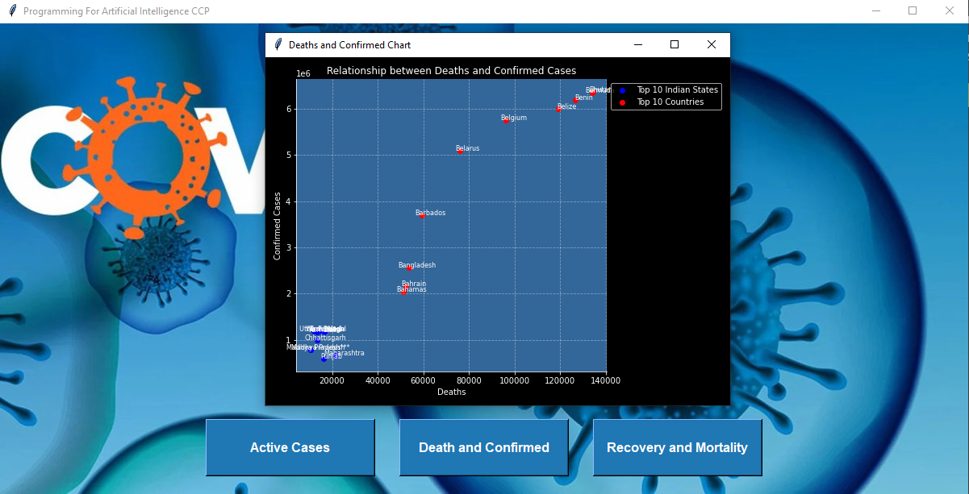
GUI VISUALIZATION (Deaths and Confirmed)

Slide 77
GUI VISUALIZATION (Deaths and Confirmed)
for i, state in enumerate(states_india):
ax.annotate(state, (deaths_india.iloc[i], confirmed_cases_india.iloc[i]),
textcoords="offset points", xytext=(10, 0), ha='center', fontsize=8)
for i, country in enumerate(countries_global):
ax.annotate(country, (deaths_global.iloc[i], confirmed_cases_global.iloc[i]),
textcoords="offset points", xytext=(10, 0), ha='center', fontsize=8)
ax.set_xlabel("Deaths")
ax.set_ylabel("Confirmed Cases")
ax.set_title("Relationship between Deaths and Confirmed Cases")
ax.grid(True, linestyle="--", alpha=0.4)
ax.legend(loc="upper left", bbox_to_anchor=(1, 1))
ax.set_facecolor((0.2, 0.4, 0.6))
ax.spines['top'].set_visible(False)
ax.spines['right'].set_visible(False)
plt.tight_layout()
canvas = FigureCanvasTkAgg(fig, master=death_confirmed_window)
canvas.draw()
canvas.get_tk_widget().pack()
death_confirmed_window.mainloop()
def show_death_confirmed():
death_confirmed_window = Toplevel(root)
death_confirmed_window.title("Deaths and Confirmed Chart")
india_data = pd.read_csv(r"C:\Users\MBG Traders\Downloads\your_dataset_without_outliers.csv")
top_10_states = india_data.groupby("State/UnionTerritory").max().nlargest(10, "Deaths")
confirmed_cases_india = top_10_states["Confirmed"]
deaths_india = top_10_states["Deaths"]
states_india = top_10_states.index
global_data = pd.read_csv(r"C:\Users\MBG Traders\Desktop\worldometer_coronavirus_daily_data.csv")
top_10_countries = global_data.groupby("country").max().nlargest(10, "Death")
confirmed_cases_global = top_10_countries["Confirmed"]
deaths_global = top_10_countries["Death"]
countries_global = top_10_countries.index
fig, ax = plt.subplots(figsize=(8, 6))
ax.scatter(deaths_india, confirmed_cases_india, color="blue", label="Top 10 Indian States")
ax.scatter(deaths_global, confirmed_cases_global, color="red", label="Top 10 Countries")

Slide 78
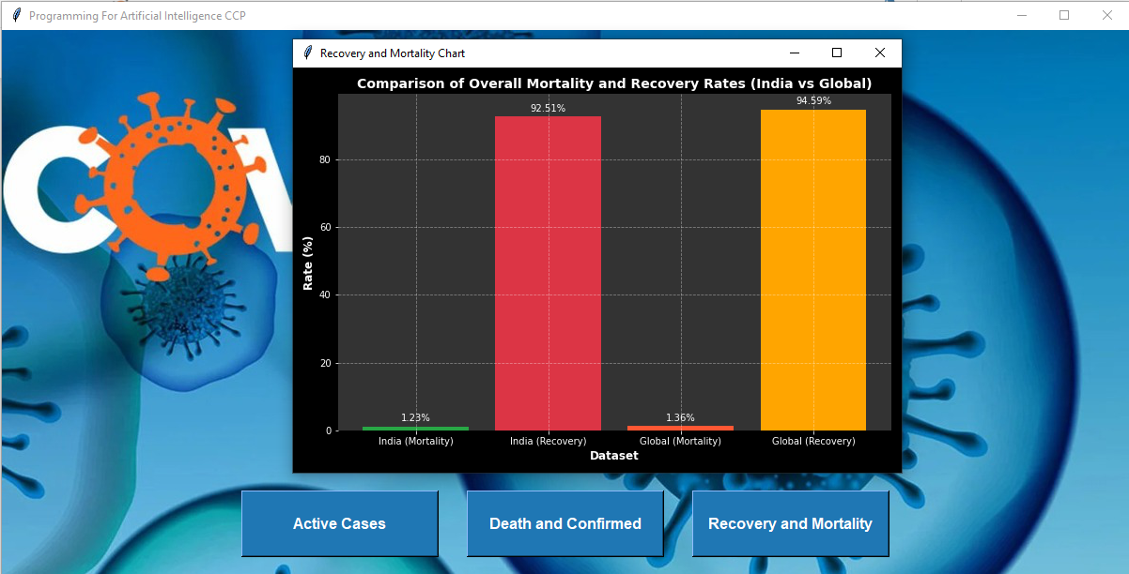
GUI VISUALIZATION (Recovery and Mortality)

Slide 79
GUI VISUALIZATION (Mortality and Recovery)
label_fontsize = 10
for i, rate in enumerate([overall_mortality_india, overall_recovery_india,
overall_mortality_global, overall_recovery_global]):
plt.text(i, rate + 1, f'{rate:.2f}%', ha='center', va='bottom',
fontsize=label_fontsize, color='white')
plt.grid(True, linestyle='--', alpha=0.4)
plt.xticks(fontsize=10, color='white')
plt.yticks(fontsize=10, color='white')
plt.gca().set_facecolor('#333333')
plt.gca().spines['top'].set_visible(False)
plt.gca().spines['right'].set_visible(False)
plt.gca().spines['bottom'].set_visible(False)
plt.gca().spines['left'].set_visible(False)
canvas = FigureCanvasTkAgg(fig, master=recovery_mortality_window)
canvas.draw()
canvas.get_tk_widget().pack()
recovery_mortality_window.mainloop()
def show_recovery_mortality():
recovery_mortality_window = Toplevel(root)
recovery_mortality_window.title("Recovery and Mortality Chart")
india_data = pd.read_csv("C:\\Users\MBG Traders\Downloads\\your_dataset_without_outliers.csv")
overall_mortality_india = (india_data['Deaths'].sum() / india_data['Confirmed'].sum()) * 100
overall_recovery_india = (india_data['Cured'].sum() / india_data['Confirmed'].sum()) * 100
global_data = pd.read_csv('C:/Users/MBG Traders/Desktop/worldometer_coronavirus_daily_data.csv')
# Calculate the overall mortality and recovery rates globally
overall_mortality_global = (global_data['Death'].sum() / global_data['Confirmed'].sum()) * 100
overall_recovery_global = (global_data['Cured'].sum() / global_data['Confirmed'].sum()) * 100
fig = plt.figure(figsize=(9, 6))
colors = ['#28a745', '#dc3545', '#ff5733', '#ffa500']
plt.bar(['India (Mortality)', 'India (Recovery)', 'Global (Mortality)', 'Global (Recovery)'],
[overall_mortality_india, overall_recovery_india, overall_mortality_global, overall_recovery_global],
color=colors)
# Set the axis labels and title
plt.xlabel('Dataset', fontsize=12, fontweight='bold', color='white')
plt.ylabel('Rate (%)', fontsize=12, fontweight='bold', color='white')
plt.title('Comparison of Overall Mortality and Recovery Rates (India vs Global)',
fontsize=14, fontweight='bold', color='white')

Slide 80
THANKYOU!!

